Slide 1
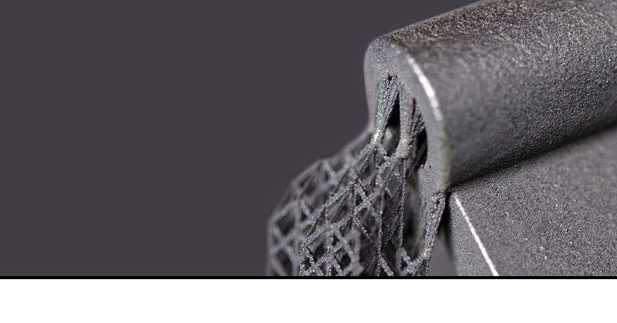
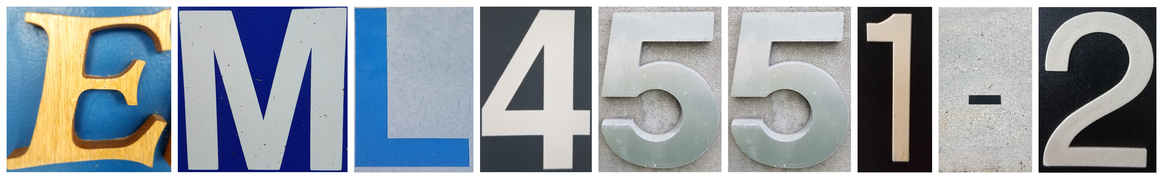
Team 501: Powder Recovery for Metal Additive Manufacturing
Arlan Ohrt
Kevin Richter
Vincent Giannetti
Noah Tipton
Joshua Dorfman
November 7th, 2019

Slide 2






Team Introductions
Vincent Giannetti
Noah Tipton
Joshua Dorfman
Arlan Ohrt
Kevin Richter
Manufacturing
Engineer
Design
Engineer
Field
Engineer
Project/Systems Engineer
Field
Engineer

Slide 3

Sponsor – Air Force Research Labs (AFRL)
AFRL/RWMW – Ordnance Division, Damage Mechanisms Branch (Eglin Air Force Base)
  A global leader in advancing weapons science and technology
Specific Contact - Dr. Philip Flater
  Lead for the metal additive manufacturing lab at AFRL/RWMW
Joshua Dorfman

Slide 4
Project Description
The objective of this project is to design a device which increases the amount of recovered steel powder in a metal additive manufacturing process. This device should be compatible with existing hardware and processes while ensuring the safety of the operators.
Joshua Dorfman

Slide 5



The Three ‘R’s
Recycle
Recover
Remove
Joshua Dorfman

Slide 6
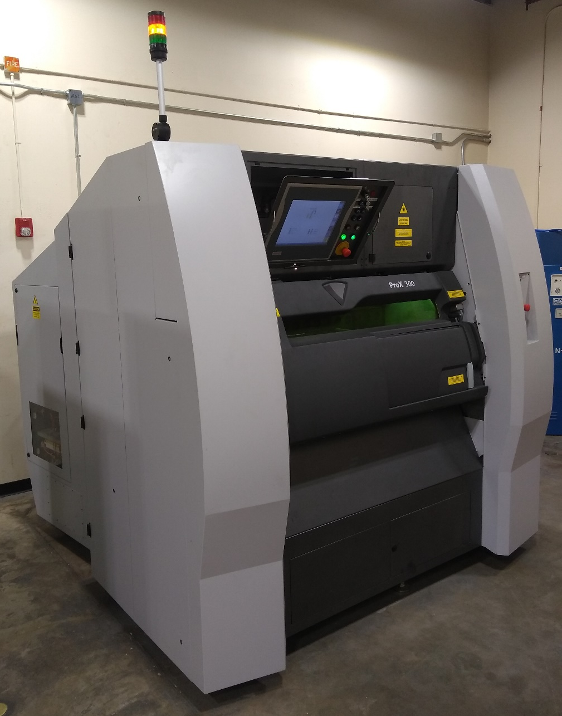
Project Background – Metal Additive Manufacturing
Laser Powder Bed Fusion (LPBF):
Powder Distributed in an Even Layer
Laser Traces Layer Path to “Fuse” Material Together
This process results in a large amount of “unfused” powder. This powder should be recycled.
AFRL’s operating 3D printer is the 3D Systems ProX 300
Joshua Dorfman

Slide 7
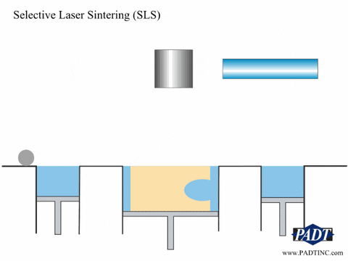
Project Background – Metal Additive Manufacturing
Laser Powder Bed Fusion (LPBF):
Powder Distributed in an Even Layer
Laser Traces Layer Path to “Fuse” Material Together
This process results in a large amount of “unfused” powder. This powder should be recycled.
Joshua Dorfman

Slide 8
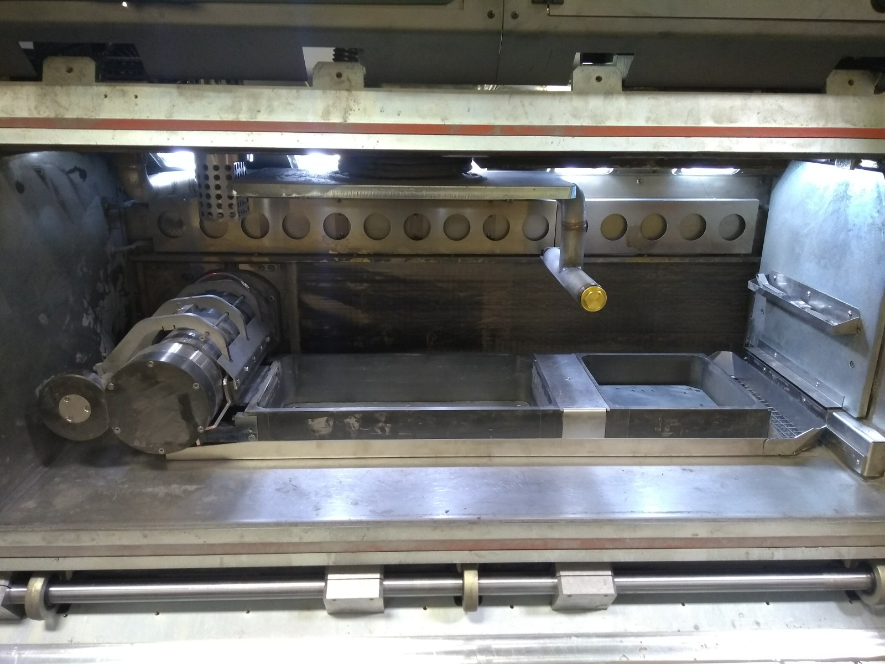
Project Background – Metal Additive Manufacturing
Powder Supply
Build Plate
Roller
Overflow
Joshua Dorfman

Slide 9
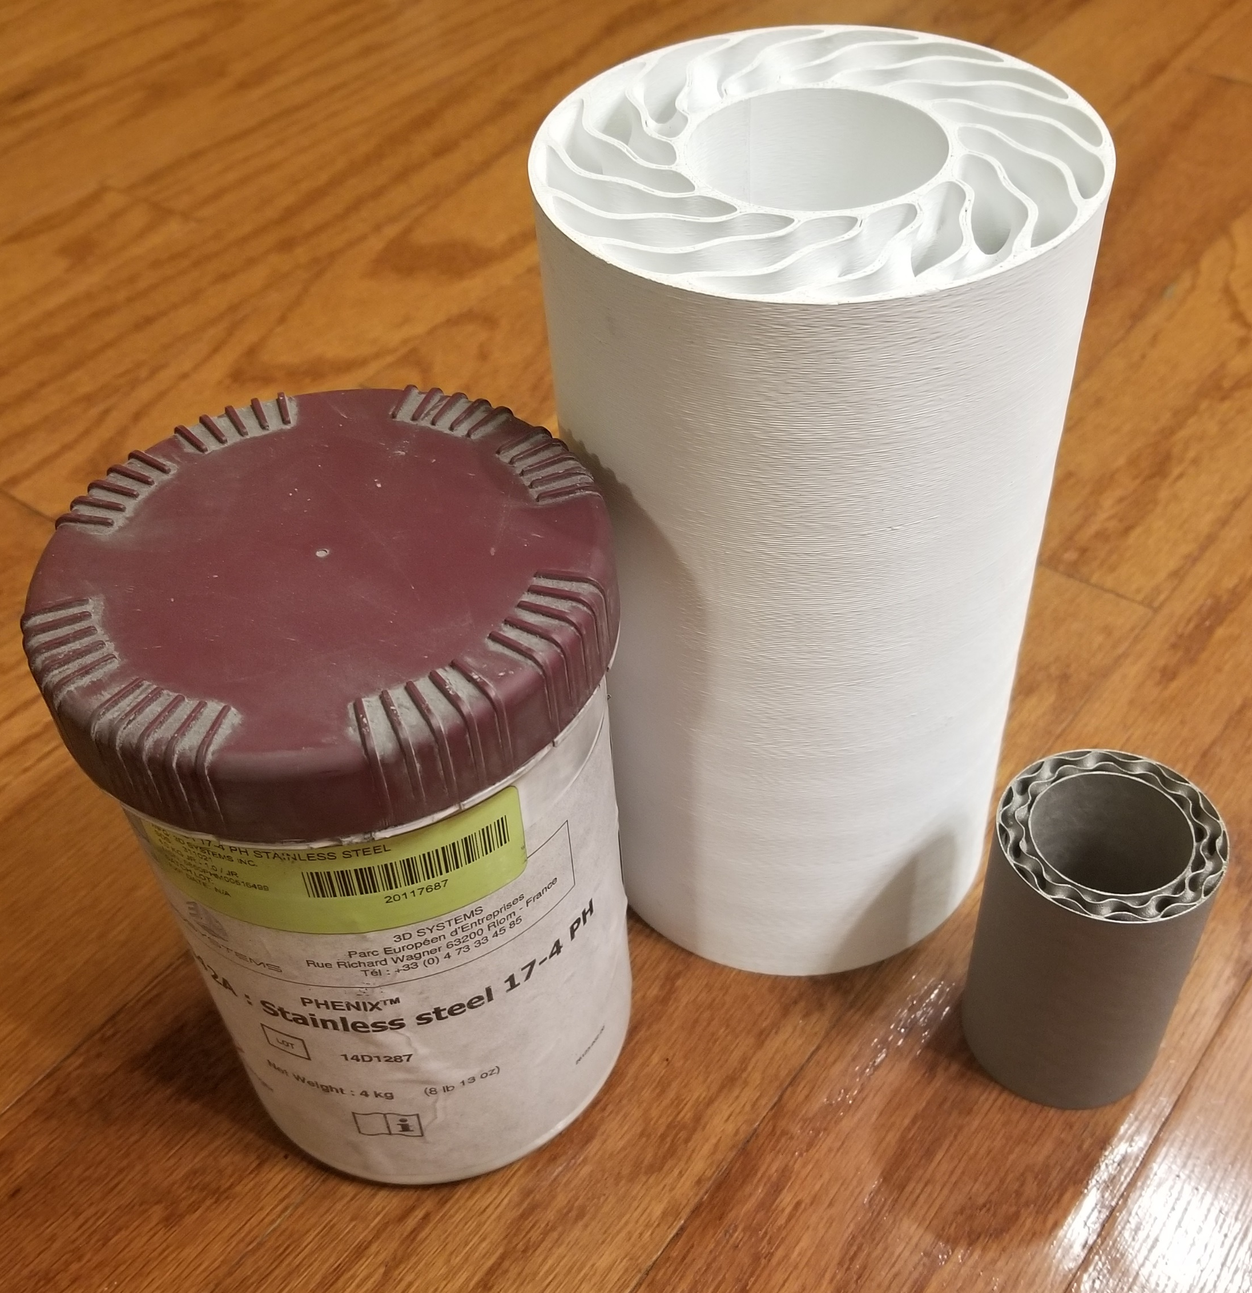
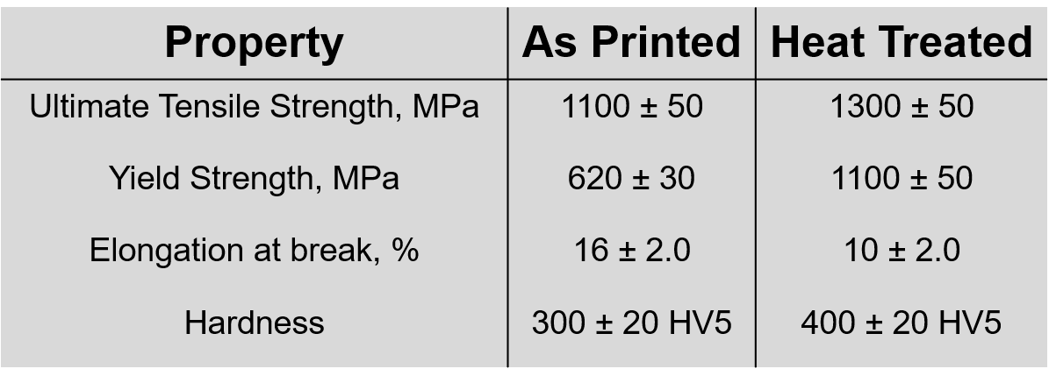
Project Background – The Metal Used
17– 4PH Stainless Steel: 17% Chromium, 4% Nickel, Precipitation Hardening
General Info:
Purchasable from 3D Systems
Particle Size: 10 – 15 μm (Paper thickness is ~ 100 μm)
Martensitic Steel (Magnetic)
Joshua Dorfman

Slide 10

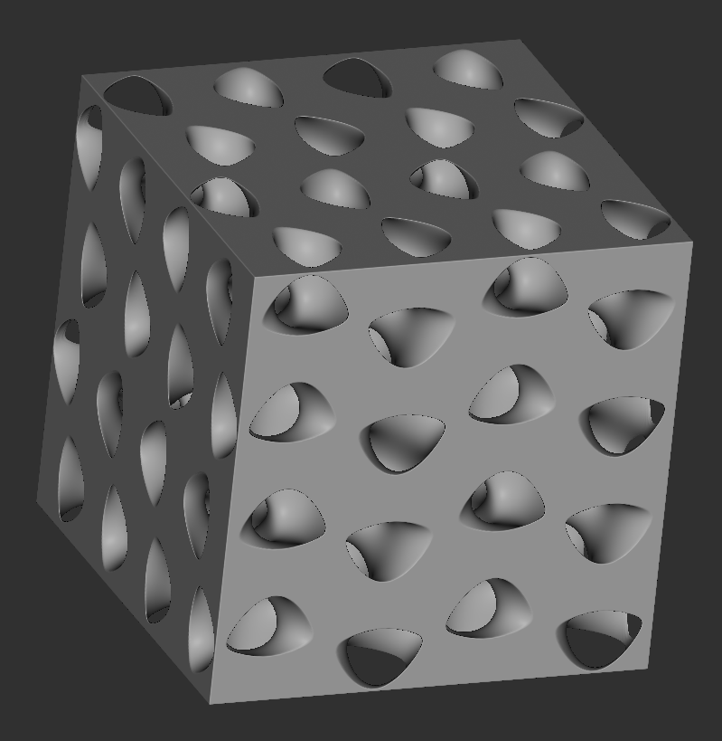
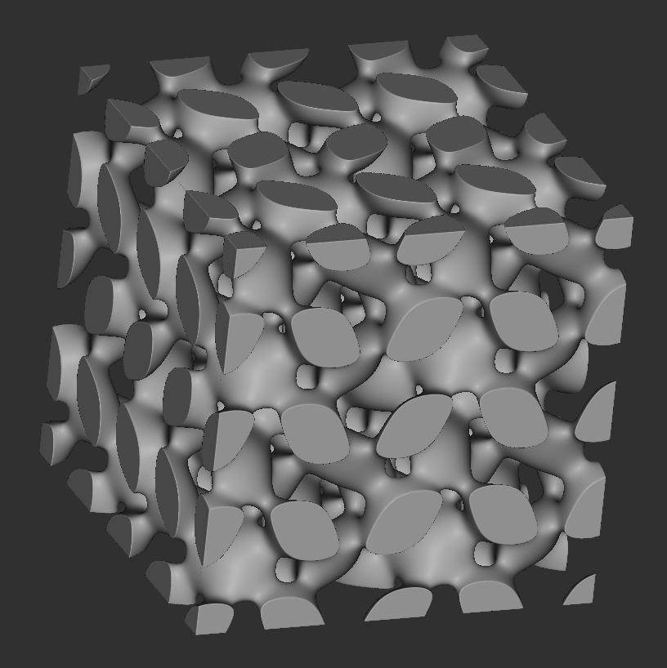
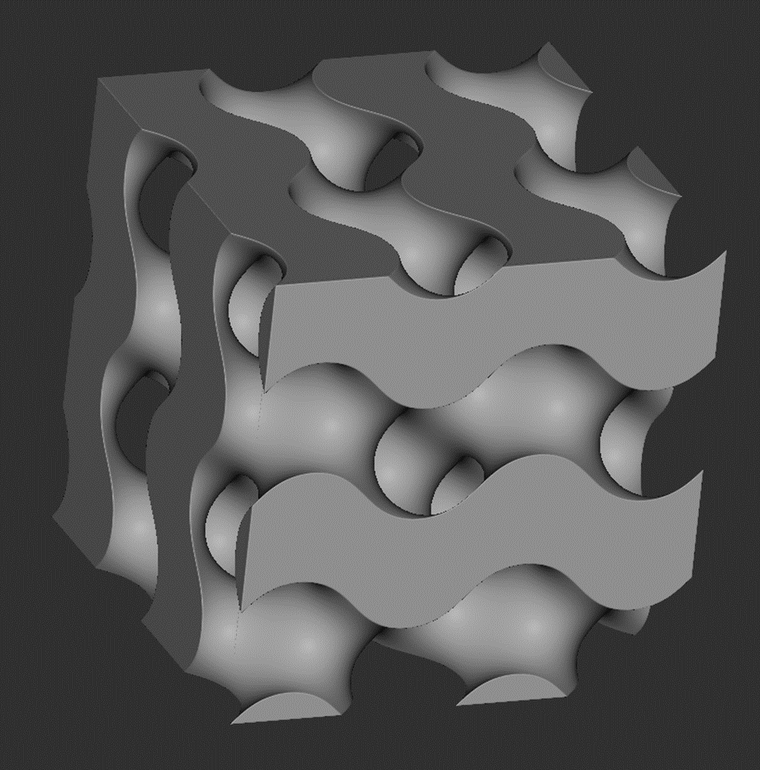
Project Background – The Metal Used
17– 4PH Stainless Steel: 17% Chromium, 4% Nickel, Precipitation Hardening
General Info:
Purchasable from 3D Systems
Particle Size: 10 – 15 μm (Paper thickness is ~ 100 μm)
Martensitic Steel (Magnetic)
Joshua Dorfman

Slide 11
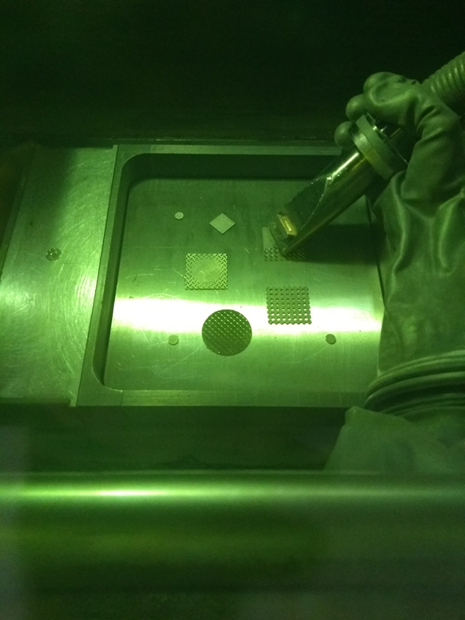
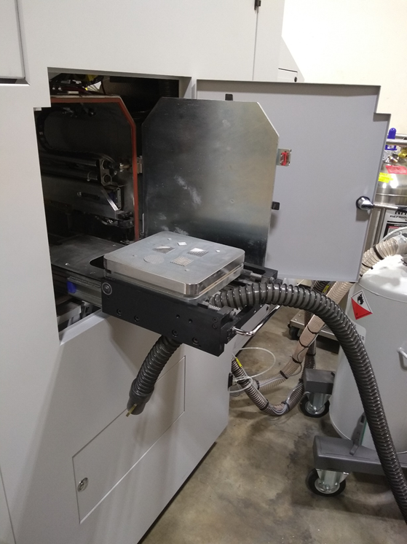
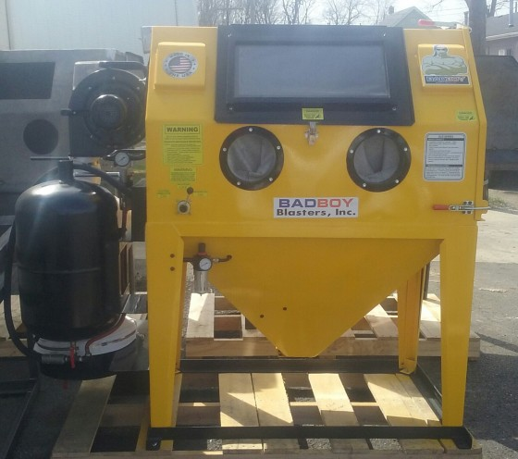
Project Background – Powder Recovery Stages
“Built In Stage”
“Wet Vac Stage”
“Air Powered Stage”
Joshua Dorfman

Slide 12
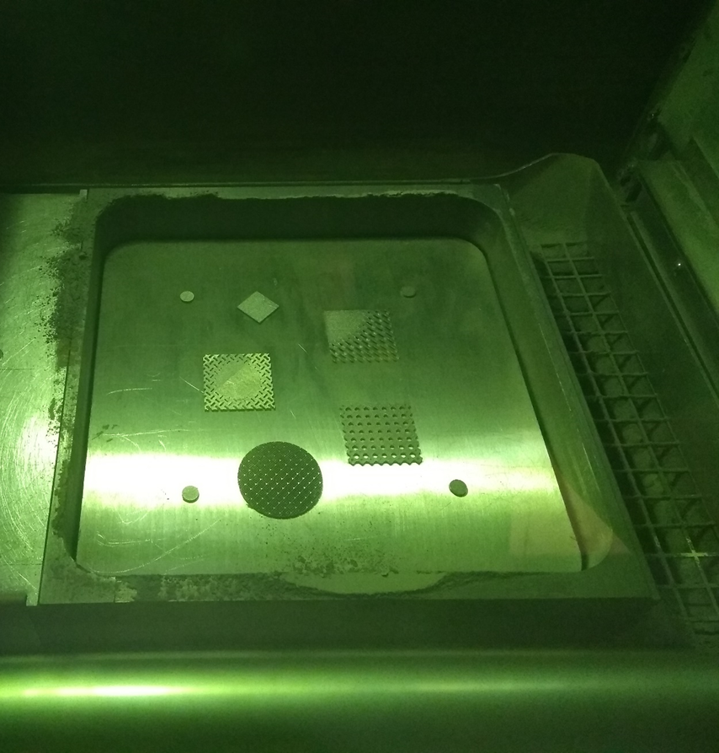
Project Background – Powder Recovery Stages
Stage 1 – “Built In Stage”
Built in recovery system
  Vacuum
  Overflow Reservoir
Operation
  Sealed chamber
  Glove to operate vacuum
Significant Powder Recovery
Joshua Dorfman

Slide 13
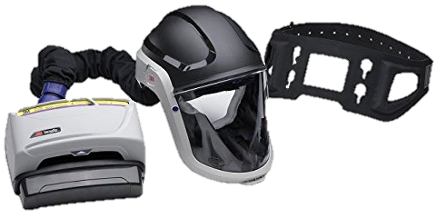
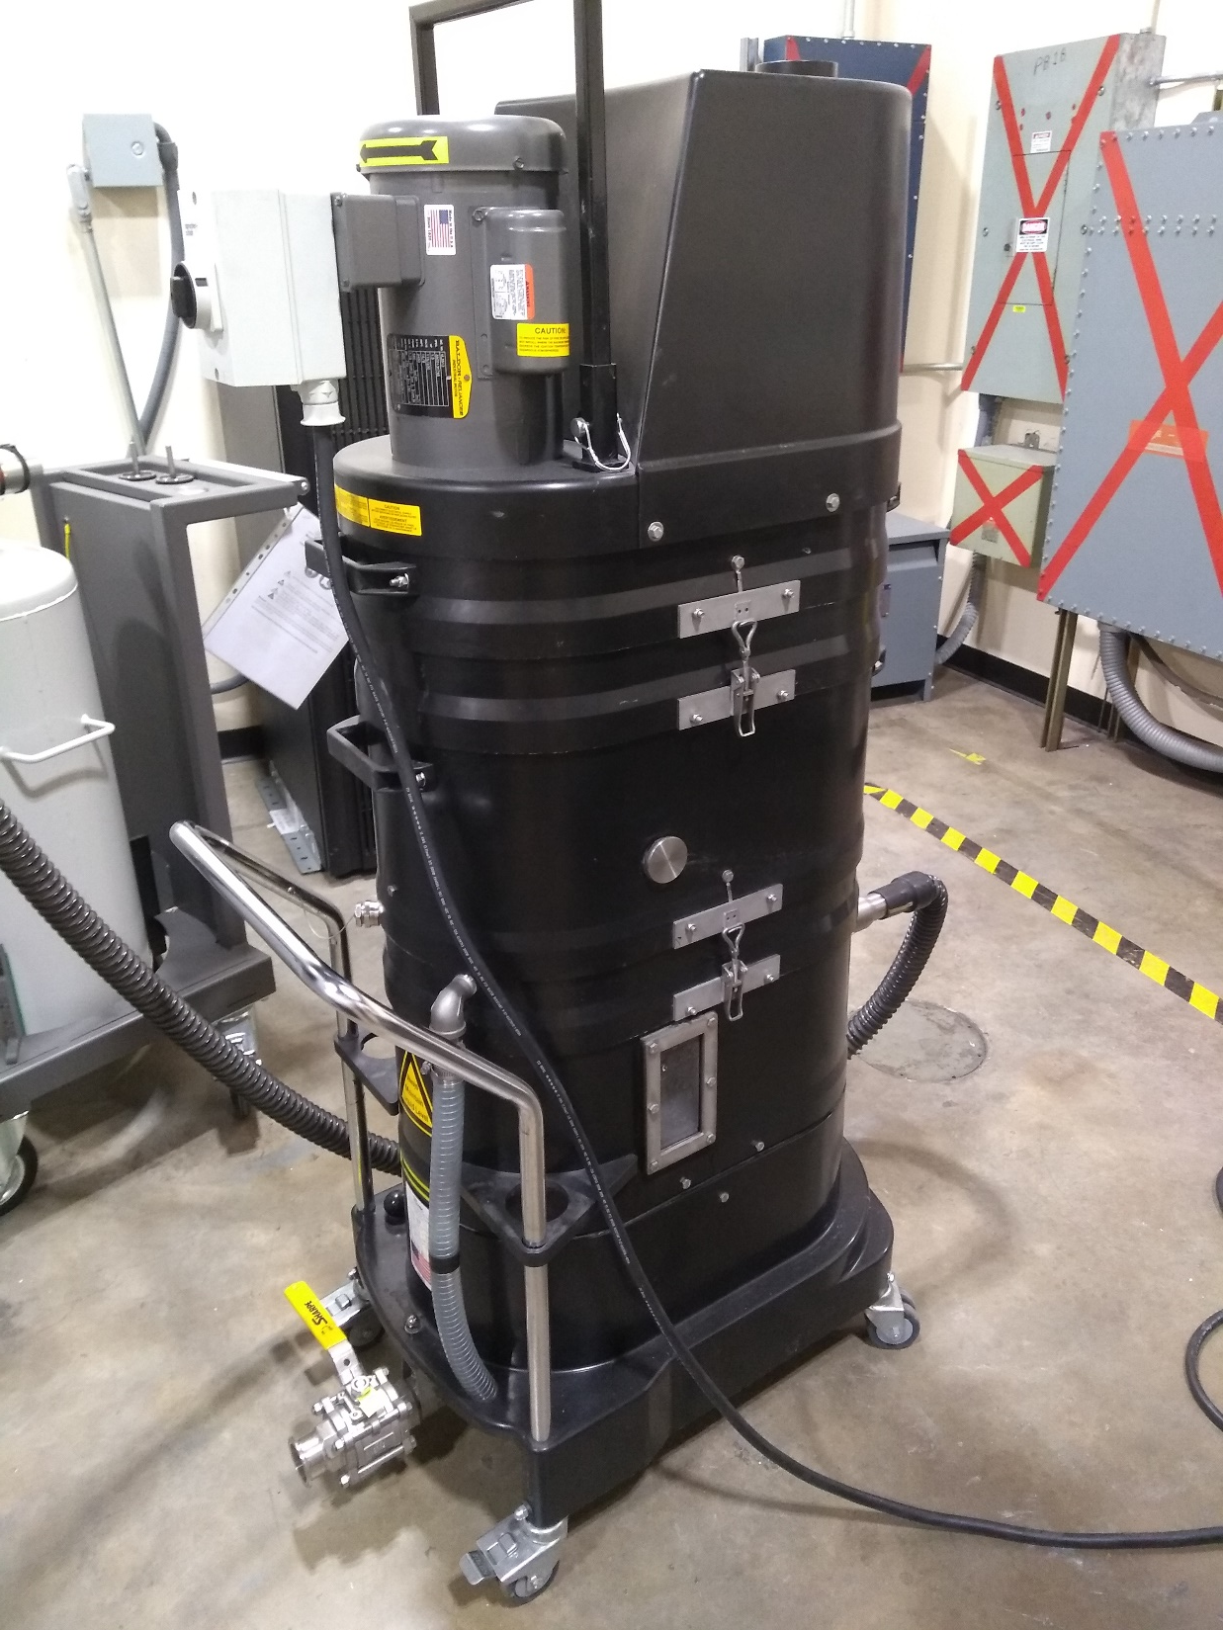
Project Background – Powder Recovery Stages
Stage 2 – “Wet Vac Stage”
Removing the part
  Pass the build plate out
Operation
  Use powered air purifying respirator (PAPR)
  Open door and remove part
  Use Ruwac NA35 Immersion Vacuum
No Powder Recovery
Joshua Dorfman

Slide 14
Project Background – Powder Recovery Stages
Stage 3 – “Air Powered Stage”
Sandblasting cabinet
Operation
  Place part inside the enclosure
  Use compressed air to remove residual powder
No Powder Recovery
Joshua Dorfman

Slide 15
Project Background – Integration
“Built In Stage”
“Wet Vac Stage”
“Air Powered Stage”
Where Our System Can Go
Joshua Dorfman

Slide 16
Project Background – Integration
Significant Powder Recovery
No Powder Recovery
Joshua Dorfman
Our System
Significant Powder Recovery

Slide 17
Project Background – Integration
Our System
Significant Powder Recovery
Joshua Dorfman

Slide 18
Project Background – Integration
Our System
Significant Powder Recovery
Joshua Dorfman

Slide 19
Concept Generation
Noah Tipton

Slide 20
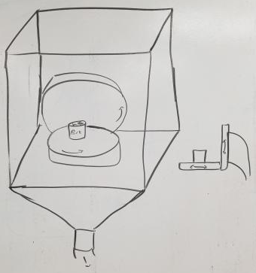
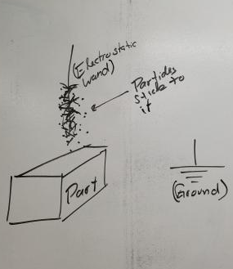
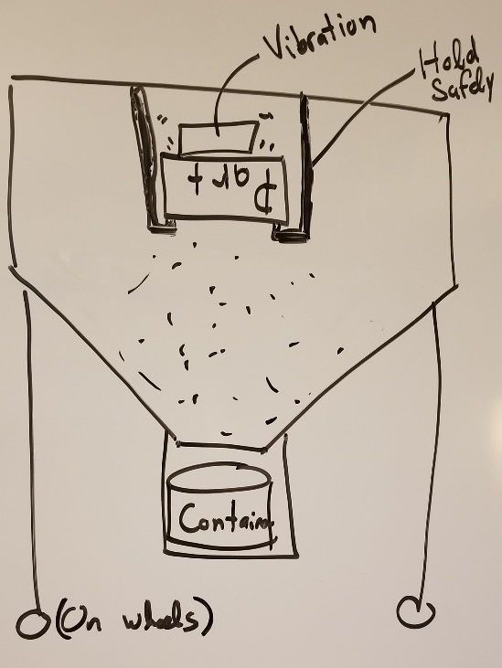
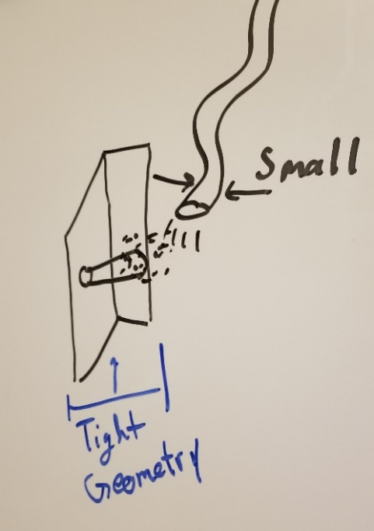
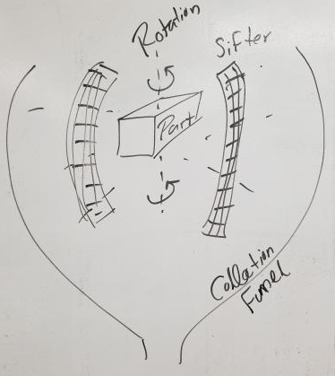
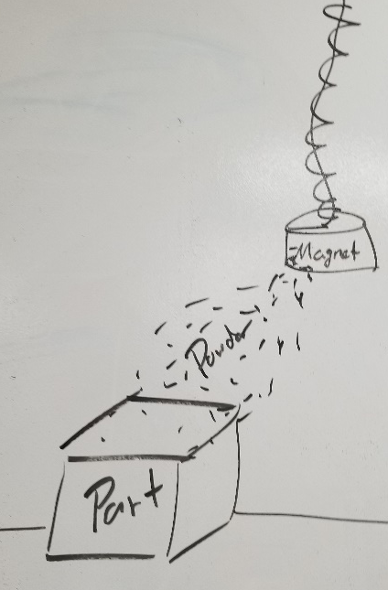
Concept Generation
Multirotational CNC
Electrostatic Wand
Encased Low to High Frequency Vibration
Tiny Tube Blower
Hanging Electromagnet
Spinning Sifter
Noah Tipton

Slide 21
Targets and Metrics - Validation
Recover Powder
Manage Powder
Support the Part
Inhibit Powder
Separates powder from the part
Transports powder
to a container
Hold the part
in the area
Isolate the powder
from user
Prevents powder contamination
Mass
Mass
1) Volume
2) Force
Up to Eglin AFB safety standards
Particle Size
Metric
Greater than 0 grams of separated powder in container
1) 250 x 250 x 300 mm
2) 356 N
Pass Bioenvironmental Engineering Flight (BEF) air test
Passes through 75 μm mesh
Target
Noah Tipton

Slide 22
Targets - Manage the Powder
We can use our product after part removal from the printer
Currently, no powder is recovered after printer removal
Any recovered powder is an improvement
No values have been measured for comparison
No Powder Recovery
Target: Greater than 0 grams of powder
Noah Tipton

Slide 23
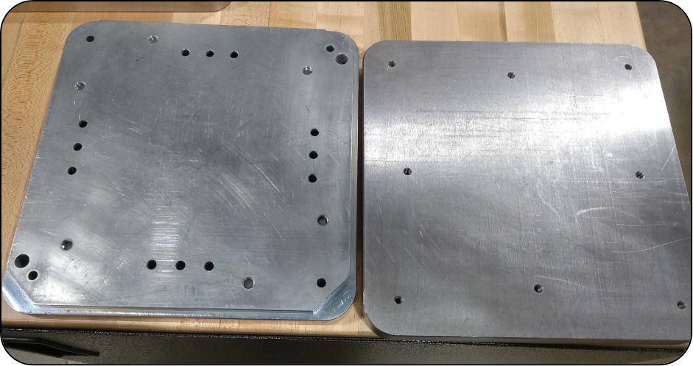
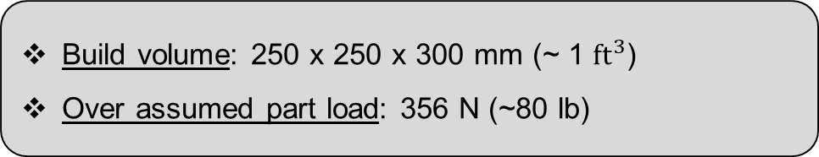
Target - Hold the Part
Build volume: 250 x 250 x 300 mm (~ 1 ${ft}^{3}$)
Over assumed part load: 356 N (~80 lb)
Target 1: Allow a volume greater than build volume
Target 2: Hold 356 N or more
Noah Tipton

Slide 24

Target – Isolate the Powder From the User
Eglin Air Force Base – Bioenvironmental Engineering Flight (BEF) Air Sampling
Contaminants in air must not exceed Occupational Environmental Exposure Limits (OEEL)
Target: Pass the BEF air sample test once product is in use
Noah Tipton

Slide 25
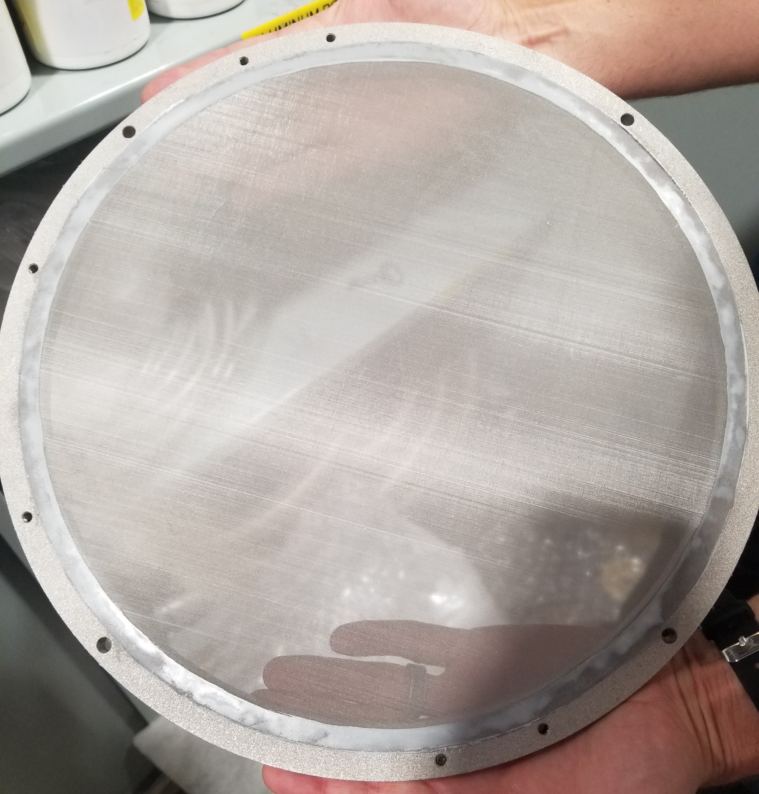
Target – Prevent Powder Contamination
Recommended to run powder through 75 μm mesh to remove contaminants
Particle shape and chemistry will not be a concern unless prints turn out bad
Target: Recovered powder passes through 75 μm stainless steel mesh
Noah Tipton

Slide 26
Concept Selection
Arlan Ohrt

Slide 27
Concept Selection
 |  | Engineering Characteristics
Improvement Direction |  | ↑ | ↑ | ↑ | ↑ | ↑ | ↓ | ↓
Units |  | Gram | Gram | Newton | Cubic Meter | Eglin AFB BEF Test | Pass through Mesh | Seconds
Customer Requirements | Importance Weight Factor | Amount of Separated Powder | Amount of Contained Powder | Supportable Load | Operable Volume | Met Safety Standards | Contamination | Added Time to Overall Process
Separate More Powder From the Part | 4 | 9 | 3 |  | 1 |  |  | 1
Recover the Separated Powder | 3 | 3 | 9 |  | 1
Prevent Powder Contamination | 5 | 1 | 1 |  |  |  | 9
Hold the Part During Process | 1 | 3 |  | 9 | 9
Ensure Operator Safety | 5 |  |  | 3 |  | 9
Integrate With Current System | 2 |  |  |  |  |  |  | 9
Raw Score | 249 | 53 | 44 | 24 | 16 | 45 | 45 | 22
Relative Weight % |  | 21.29 | 17.67 | 9.64 | 6.43 | 18.07 | 18.07 | 8.84
Rank Order |  | 1 | 4 | 5 | 7 | 2 | 2 | 6
Methods:
House of Quality
Pugh Charts
Analytical Hierarchy Process (AHP)
Arlan Ohrt

Slide 28
Concept Selection
 |  | Concepts
Engineering Characteristics | Current Recovery Process | Tiny Tube Blower | Encased Low to High Frequency Vibration | Hanging Faucet Electromagnet | Electrostatic Brush | CNC Axis Part Mover | Spinning Sifter | Vibration Through all Stages | Multi-Directional Vibration
Amount of Separated Powder | DATUM | + | + | + | + | + | + | + | +
Amount of Contained Powder |  | + | + | + | + | + | + | + | +
Supportable Load |  | S | S | S | S | - | - | - | -
Operable Volume |  | S | S | S | S | S | S | S | S
Met Safety Standards |  | S | S | S | S | S | S | S | S
Contamination |  | S | + | S | S | S | + | S | S
Added Time to Overall Process |  | - | - | - | S | S | - | - | -
Total + |  | 2 | 3 | 2 | 2 | 2 | 3 | 2 | 2
Total - |  | 1 | 1 | 1 | 0 | 1 | 2 | 2 | 2
Methods:
House of Quality
Pugh Charts
Analytical Hierarchy Process (AHP)
Arlan Ohrt

Slide 29
Concept Selection
 |  | Concepts
Engineering Characteristics | Current Recovery Process | Tiny Tube Blower | Encased Low to High Frequency Vibration | Hanging Faucet Electromagnet | Electrostatic Brush | CNC Axis Part Mover | Spinning Sifter | Vibration Through all Stages | Multi-Directional Vibration
Amount of Separated Powder | DATUM | + | + | + | + | + | + | + | +
Amount of Contained Powder |  | + | + | + | + | + | + | + | +
Supportable Load |  | S | S | S | S | - | - | - | -
Operable Volume |  | S | S | S | S | S | S | S | S
Met Safety Standards |  | S | S | S | S | S | S | S | S
Contamination |  | S | + | S | S | S | + | S | S
Added Time to Overall Process |  | - | - | - | S | S | - | - | -
Total + |  | 2 | 3 | 2 | 2 | 2 | 3 | 2 | 2
Total - |  | 1 | 1 | 1 | 0 | 1 | 2 | 2 | 2
Methods:
House of Quality
Pugh Charts
Analytical Hierarchy Process (AHP)
Arlan Ohrt

Slide 30
Concept Selection
 |  | Concepts
Engineering Characteristics | Electrostatic Brush | Tiny Tube Blower | Encased Low to High Frequency Vibration | Hanging Faucet Electromagnet | CNC Axis Part Mover
Amount of Separated Powder | DATUM | S | + | - | S
Amount of Contained Powder |  | + | + | - | S
Supportable Load |  | S | S | S | -
Operable Volume |  | S | S | S | S
Met Safety Standards |  | S | S | S | S
Contamination |  | + | + | S | +
Added Time to Overall Process |  | S | - | S | S
Total + |  | 2 | 3 | 0 | 1
Total - |  | 0 | 1 | 2 | 1
Methods:
House of Quality
Pugh Charts
Analytical Hierarchy Process (AHP)
Arlan Ohrt

Slide 31
Concept Selection
 |  | Concepts
Engineering Characteristics | Electrostatic Brush | Tiny Tube Blower | Encased Low to High Frequency Vibration | Hanging Faucet Electromagnet | CNC Axis Part Mover
Amount of Separated Powder | DATUM | S | + | - | S
Amount of Contained Powder |  | + | + | - | S
Supportable Load |  | S | S | S | -
Operable Volume |  | S | S | S | S
Met Safety Standards |  | S | S | S | S
Contamination |  | + | + | S | +
Added Time to Overall Process |  | S | - | S | S
Total + |  | 2 | 3 | 0 | 1
Total - |  | 0 | 1 | 2 | 1
Methods:
House of Quality
Pugh Charts
Analytical Hierarchy Process (AHP)
Arlan Ohrt

Slide 32
Concept Selection
 |  | Concepts
Engineering Characteristics | Electrostatic Brush | Tiny Tube Blower | Encased Low to High Frequency Vibration | Hanging Faucet Electromagnet | CNC Axis Part Mover
Amount of Separated Powder | DATUM | S | + | - | S
Amount of Contained Powder |  | + | + | - | S
Supportable Load |  | S | S | S | -
Operable Volume |  | S | S | S | S
Met Safety Standards |  | S | S | S | S
Contamination |  | + | + | S | +
Added Time to Overall Process |  | S | - | S | S
Total + |  | 2 | 3 | 0 | 1
Total - |  | 0 | 1 | 2 | 1
Methods:
House of Quality
Pugh Charts
Analytical Hierarchy Process (AHP)
Arlan Ohrt

Slide 33
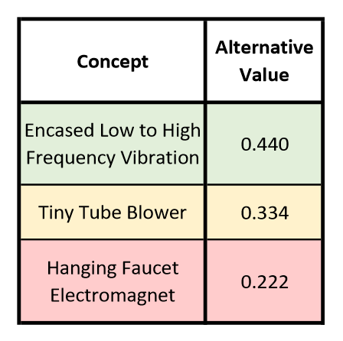
Concept Selection
Methods:
House of Quality
Pugh Charts
Analytical Hierarchy Process (AHP)
The 19 Matrices of Work Will Not Be Covered
Arlan Ohrt

Slide 34
Selected Concept
Encased Low to High Frequency Vibration
Function
Design Aspect
Target
Separates
Vibration
Over 0 grams
Contains
Funnel + Gravity
Holds
Upside-Down
Force & Volume
Isolates
Enclosure
BEF Test
Non-Contaminated
Dedicated
75 μm Mesh
Arlan Ohrt

Slide 35
Selected Concept
Encased Low to High Frequency Vibration
Function
Design Aspect
Target
Separates
Vibration
Over 0 grams
Contains
Funnel + Gravity
F
Holds
Upside-Down
Force & Volume
Isolates
Enclosure
BEF Test
Non-Contaminated
Dedicated
75 μm Mesh
Arlan Ohrt

Slide 36
Selected Concept
Encased Low to High Frequency Vibration
Function
Design Aspect
Target
Separates
Vibration
Over 0 grams
Contains
Funnel + Gravity
F
Holds
Upside-Down
Force & Volume
Isolates
Enclosure
BEF Test
Non-Contaminated
Dedicated
75 μm Mesh
Arlan Ohrt

Slide 37
Selected Concept
Encased Low to High Frequency Vibration
Function
Design Aspect
Target
Separates
Vibration
Over 0 grams
Contains
Funnel + Gravity
Holds
Upside-Down
Force & Volume
Isolates
Enclosure
BEF Test
Powder Recovery ONLY
Non-Contaminated
Dedicated
75 μm Mesh
Arlan Ohrt

Slide 38
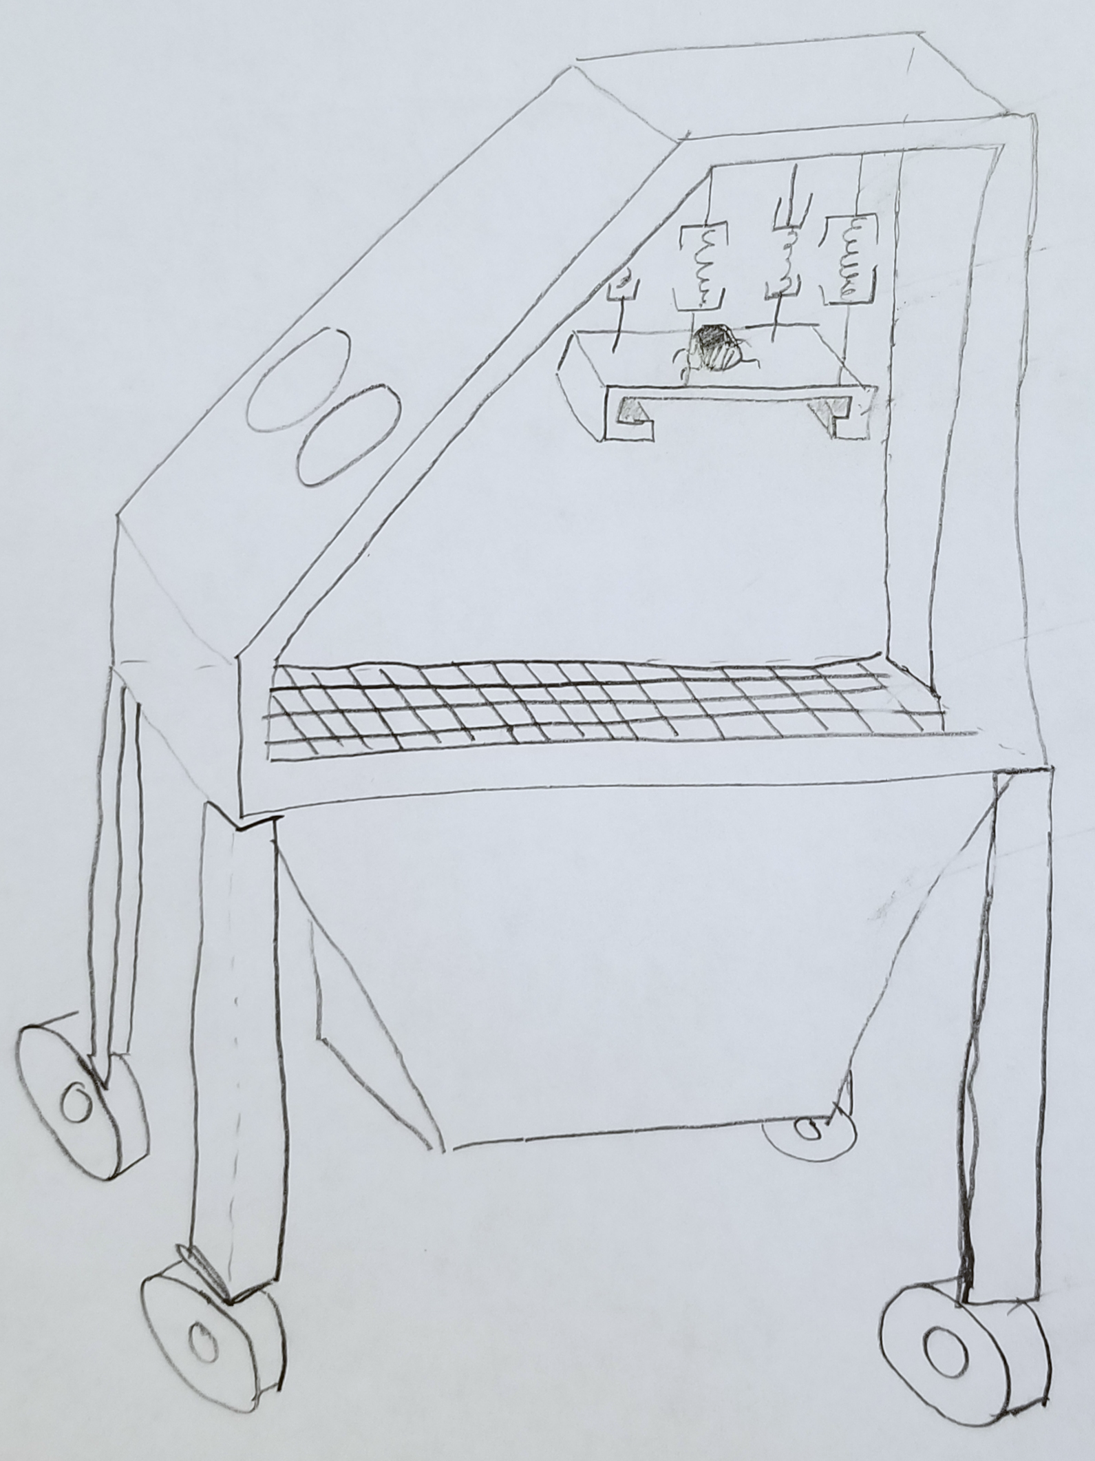
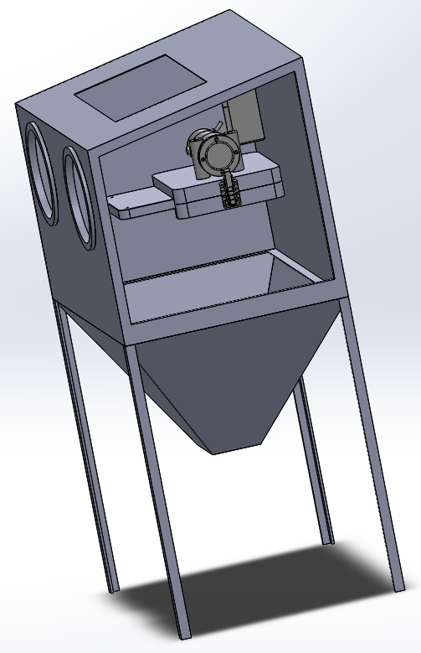
Selected Concept
Encased Low to High Frequency Vibration
Function
Design Aspect
Target
Separates
Vibration
Over 0 grams
Contains
Funnel + Gravity
Powder Recovery ONLY
Holds
Upside-Down
Force & Volume
Isolates
Enclosure
BEF Test
Non-Contaminated
Dedicated
75 μm Mesh
Arlan Ohrt

Slide 39
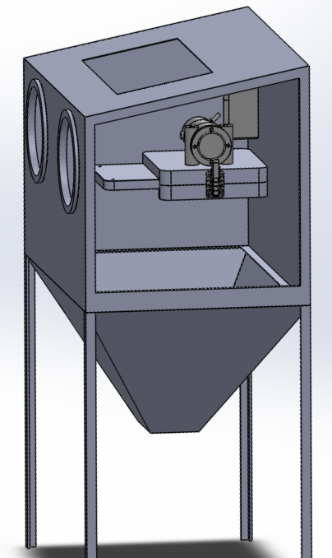
Refining the Concept
Arlan Ohrt

Slide 40
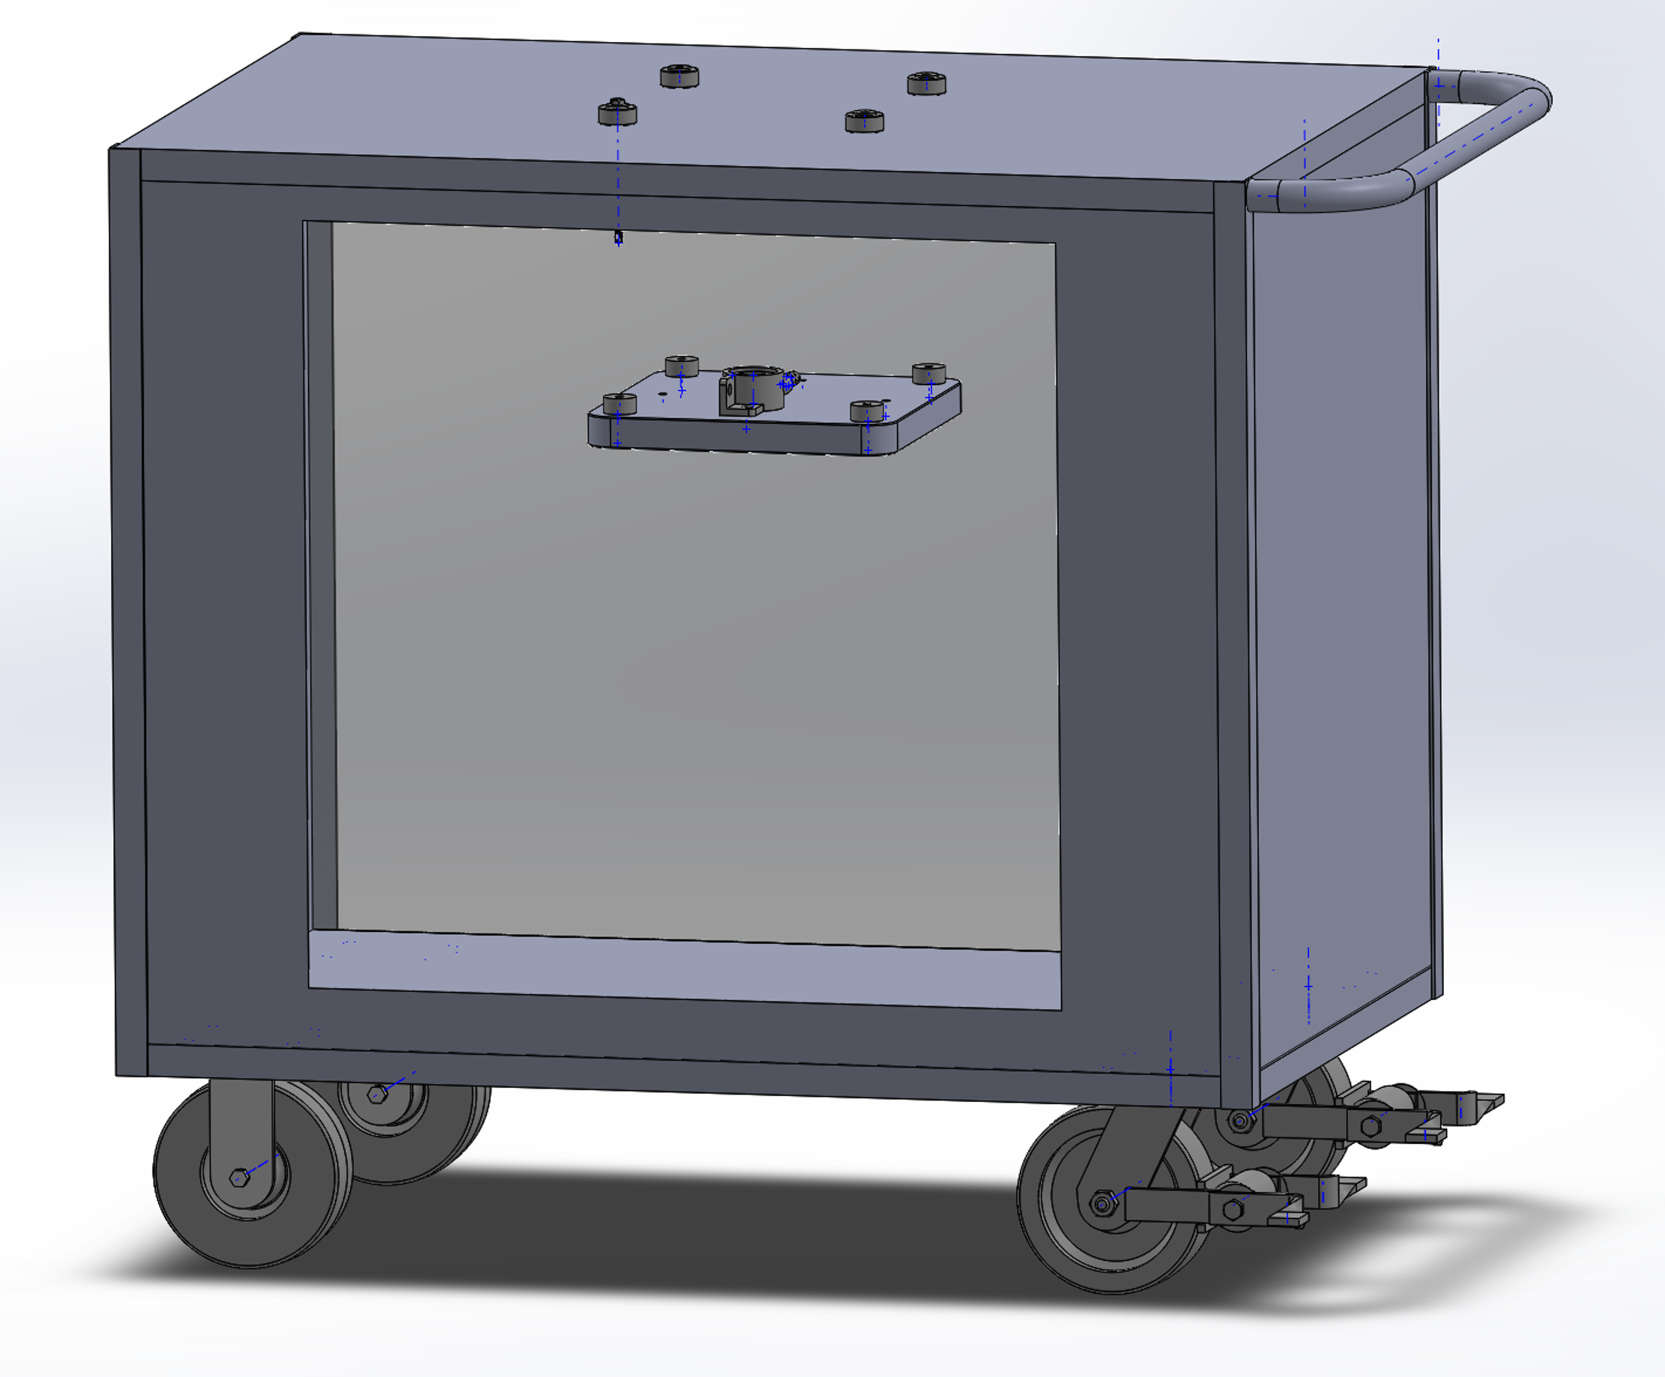
Refining the Concept – Post Eglin Visit
Arlan Ohrt

Slide 41
Refining the Concept – Enclosure
Cart Benefits:
Size
Maneuverability
Dedicated Interior, Free Exterior
Arlan Ohrt

Slide 42
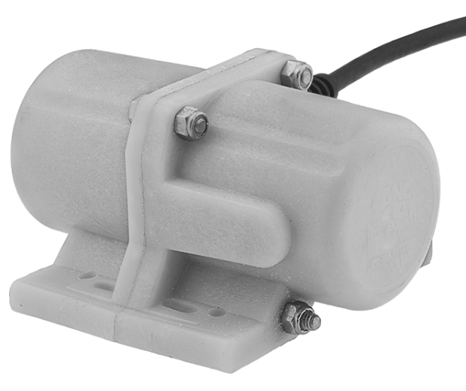
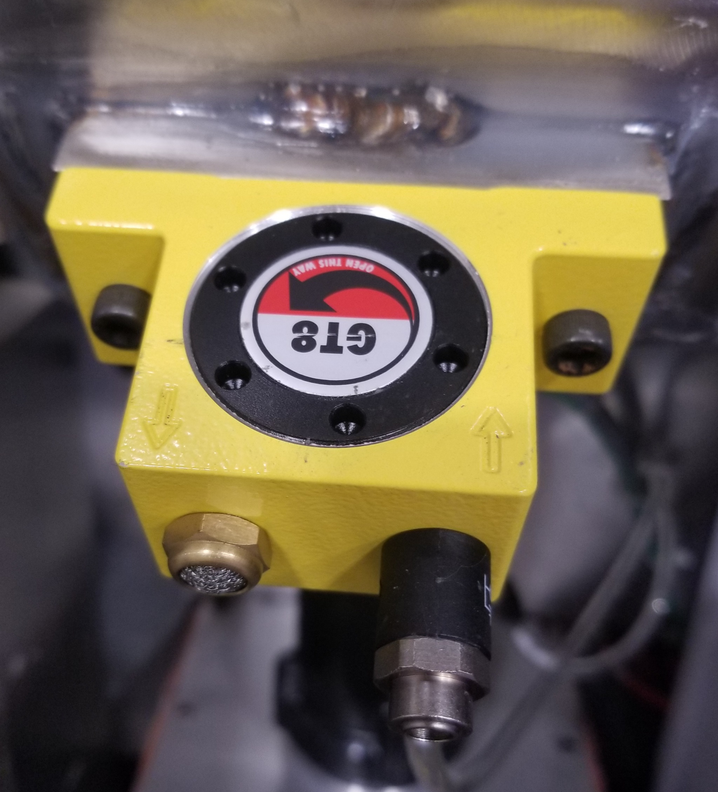
Refining the Concept – Vibration
Arlan Ohrt

Slide 43
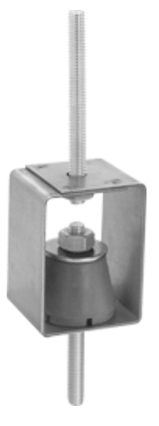
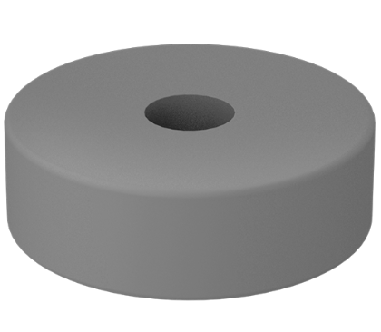
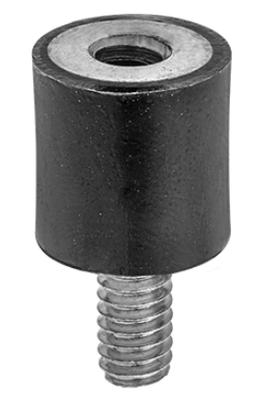
Refining the Concept – Damping
Arlan Ohrt

Slide 44
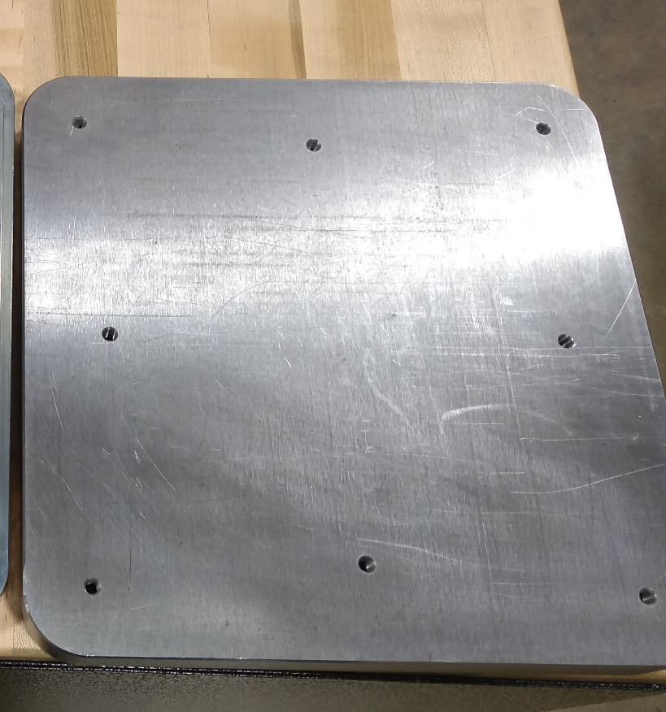
Refining the Concept – Holding Part
Arlan Ohrt

Slide 45
What is Next?
Future Work:
Continue Refining Design
Continue Specifying Needed Parts
Finalize for Assembly, Testing, and Refinements in the Spring
Explore the utilization of nodal frequency
Arlan Ohrt

Slide 46
References
Title Slide Background - https://www.materialise.com/en/blog/when-how-and-where-of-metal-3d-printing
Lost and Found - https://www.portseattle.org/sites/default/files/2019-08/bigstock_lost_1140.jpg?slideshow=true&slideshowAuto=false&slideshowSpeed=4000&speed=350&transition=elastic
Recycle Bin - http://fridandrussell.com/SH_productdetail.asp?Ino=61517U06C&Company=STX
Painter’s Tape - https://www.scotchblue.com/3M/en_US/scotchblue/proper-tape-removal/
3D Systems – https://www.3dsystems.com/3d-printers/prox-dmp-300/specifications
LPBF Demo GIF - https://thescopepopculturescience.blogspot.com/2015_01_01_archive.html
Stainless Steel Properties - https://www.3dsystems.com/materials/metal
nTopology – https://ntopology.com/
PAPR – https://images-na.ssl-images-amazon.com/images/I/4125zPcBPNL.jpg
Sandblaster - https://badboyblasters.com/product/abrasive-media-sand-blaster-bb1050led-bvr-pr-hv-fl-2/
AFRL Sign - https://news.wfsu.org/post/eglin-air-force-base-ready-adjust-hiring-freeze
Electric Vibrator - https://www.mcmaster.com/5808k61
Dampeners - https://www.mcmaster.com/29895t54 , https://www.mcmaster.com/9241k44
Arlan Ohrt

Slide 47
Team 501: Powder Recovery for Metal Additive Manufacturing
Arlan Ohrt
Kevin Richter
Vincent Giannetti
Noah Tipton
Joshua Dorfman
November 7th, 2019

Slide 48
Backup Slides
Return

Slide 49
Backup Slides
3D Systems Printer Specs
Functional Decomposition
Precipitation Hardening Explained
Group Member Contact
17- 4PH Material
nTopology
Return

Slide 50
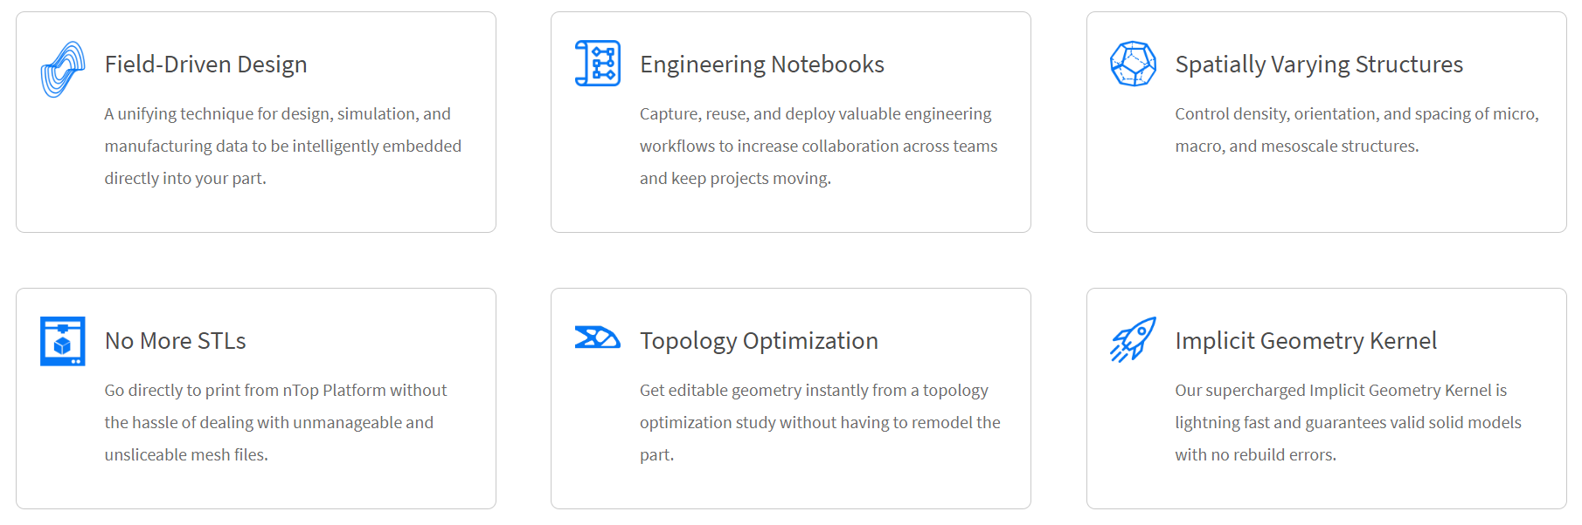
Return

Slide 51
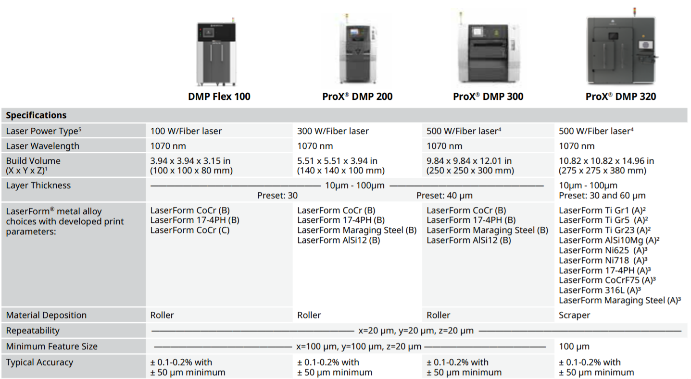
Return

Slide 52
Group Contact
Vincent Giannetti
Noah Tipton
Joshua Dorfman
Arlan Ohrt
Kevin Richter
vjg15b@my.fsu.edu
nrt15@my.fsu.edu
jd16s@my.fsu.edu
ago16b@my.fsu.edu
kr15@my.fsu.edu
Return

Slide 53
Functional Decomposition
Recover Powder
Manage Powder
Support the Part
Inhibit Powder
Separates powder from the part
Holds the part in the area
Insulates the user from powder
Transports powder to a container
Prevents powder contamination
Return

Slide 54
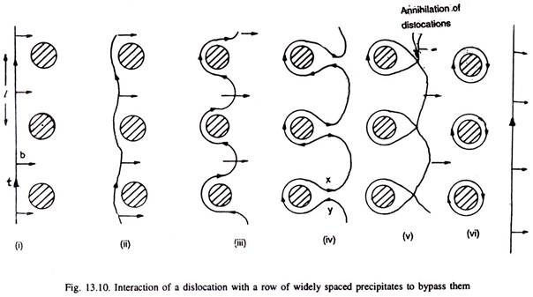
Precipitation Hardening Explained
The strength and hardness of some materials can be increased by the formation of very small particles
This is done through heat treatments
It is called “Precipitation Hardening” because the process results in very small particles, called “Precipitates”
This works because precipitates help block dislocation motion, which is an important aspect of a materials failure and properties
http://www.engineeringenotes.com/metallurgy/age-hardening-treatment/age-hardening-treatment-of-metals-metallurgy/26376
Return

Slide 55
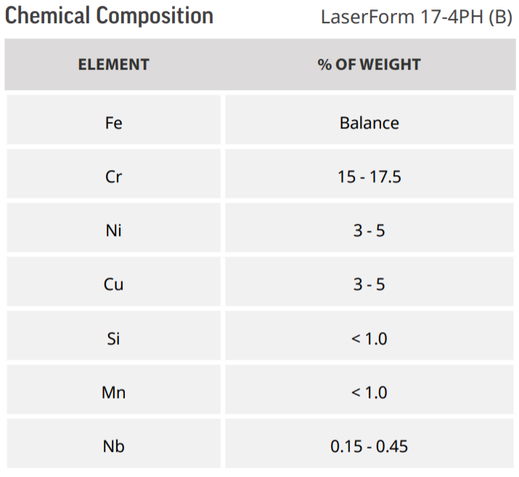
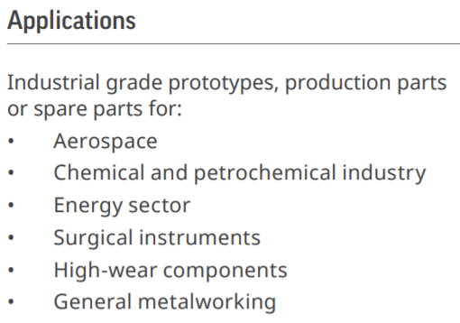
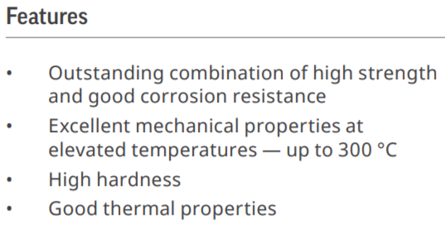
17- 4PH Stainless Steel
https://www.3dsystems.com/sites/default/files/2017-06/3D-Systems_17-4_PH_%28B%29_DMP_DATASHEET_US_A4_2017.06.21_WEB.pdf
Return

Slide 56
Arlan Ohrt

Slide 57
Standard Shapes
Summary Box
Text box 1
Outlined Text Box

Slide 58




Approved Logos

Slide 59
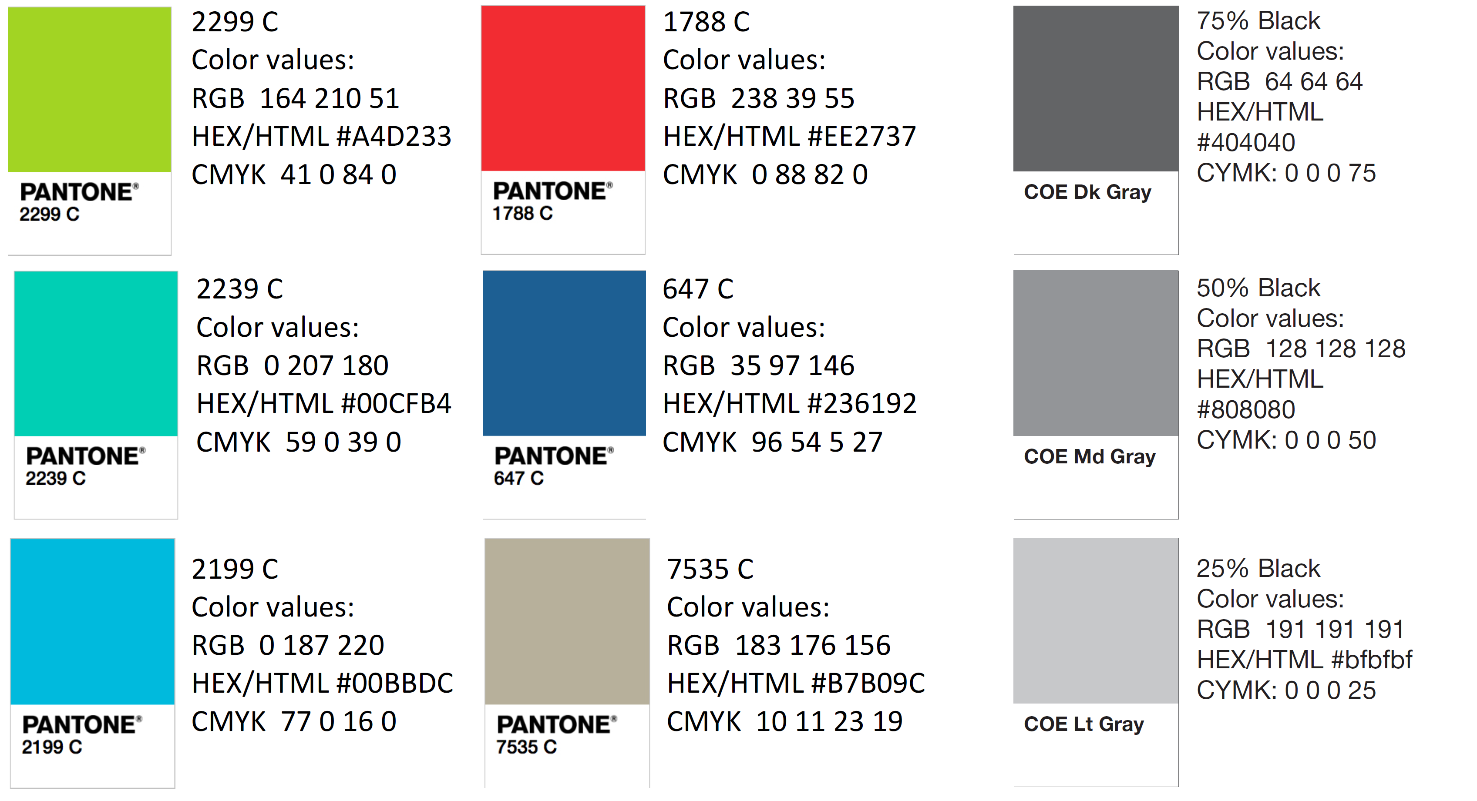
Color Palette

Slide 60
APA Tables
Category 1 | Category 2 | Category 3 | Category 4 | Category 5
Item 1
Item 2
Item 3
Item 4
 | Category 2 |  |  | Category 3
Category 1 | subcategory 1 | subcategory 2 |  | subcategory 1 | subcategory 2
Item 1
Item 2
Item 3
Item 4

